Slide 1

Sensor Status Prediction And Lag Time Analysis
Jinghan Gu, Liang Chen, Danlin Zuo

Slide 2
Business Motivation
More Accurate Prediction on Sensor Status
More Preparation Time & Less ‘Red’ Sensor Status
Better Working Agenda + Saving Time & Money

Slide 3
Goals
Predict if a dispenser will run out of product at the next state
Analyze the average lag time between alert and refill

Slide 4
Data Visualization
Customer sites across the world
Flow of people at the given site and location
Dispenser type and number analysis
Refill lag time analysis

Slide 5
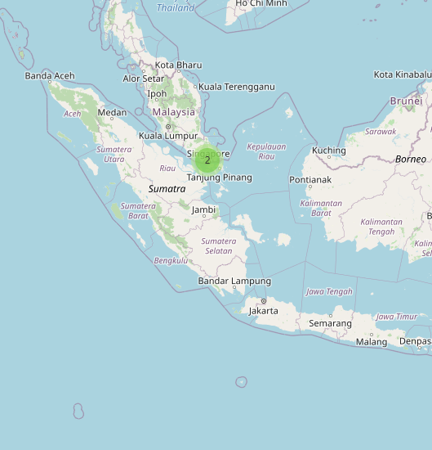
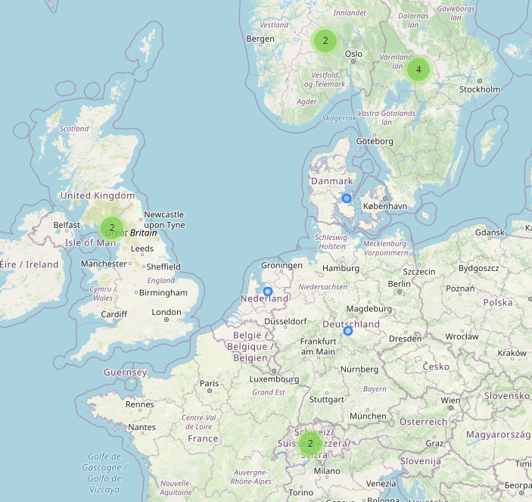
Example Site Locations

Slide 6
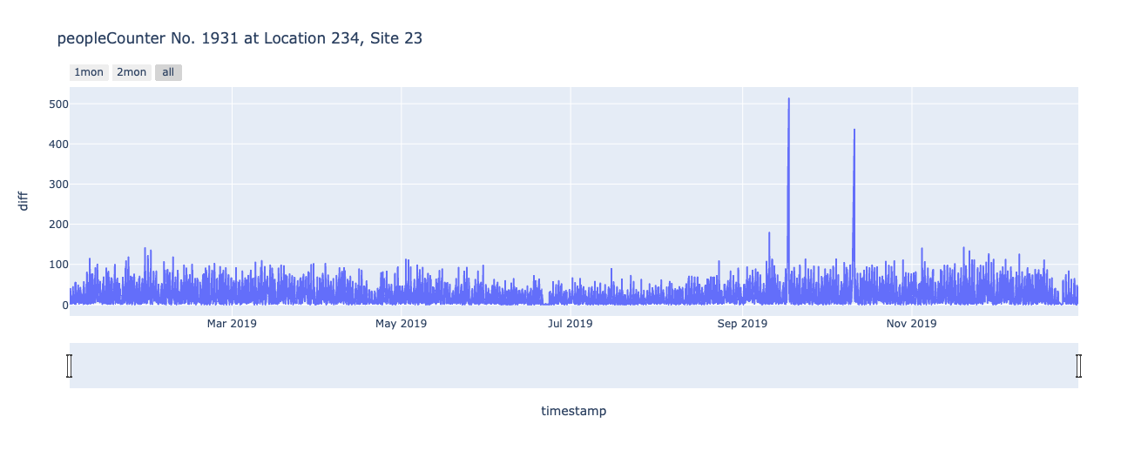
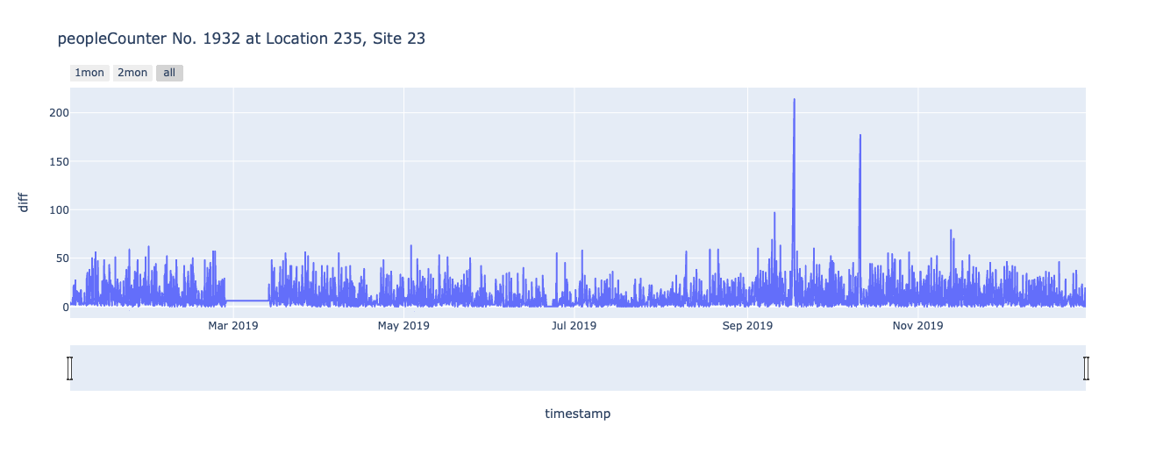
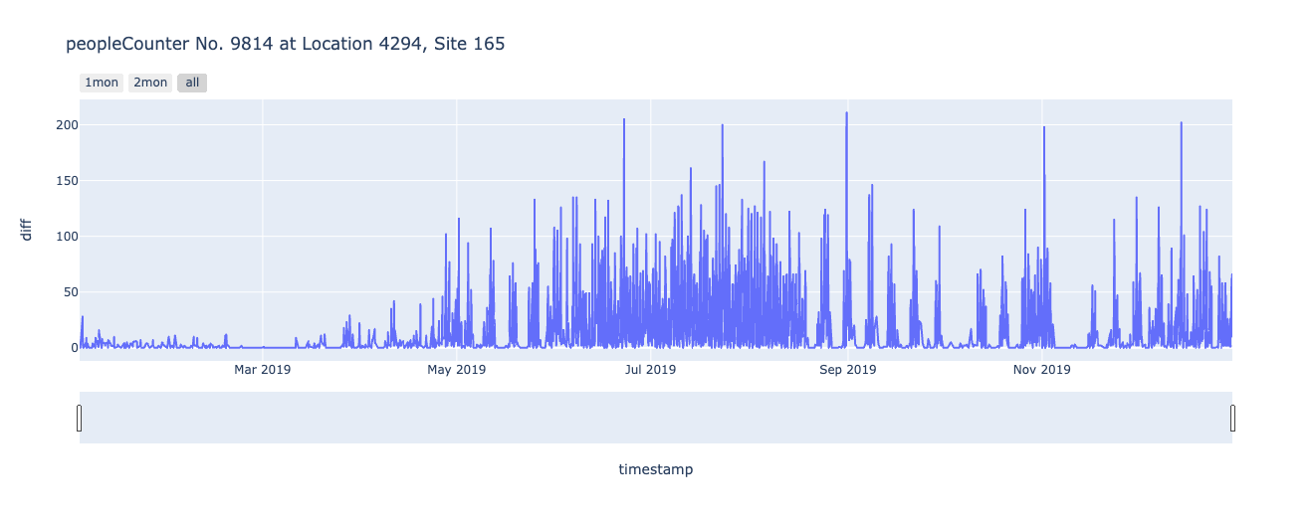
Flow of People at Different Locations

Slide 7
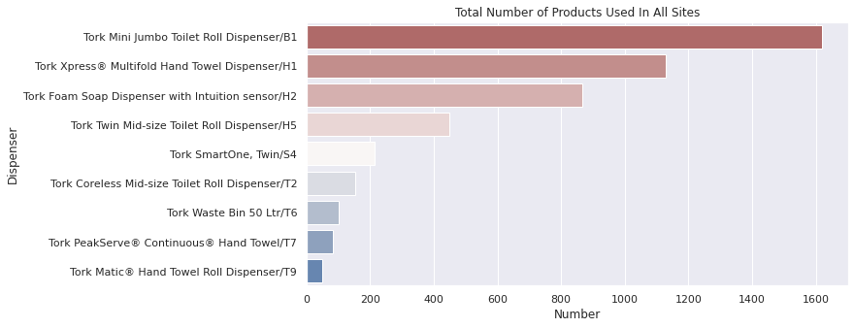
Lag Time Analysis For Dispensers

Slide 8
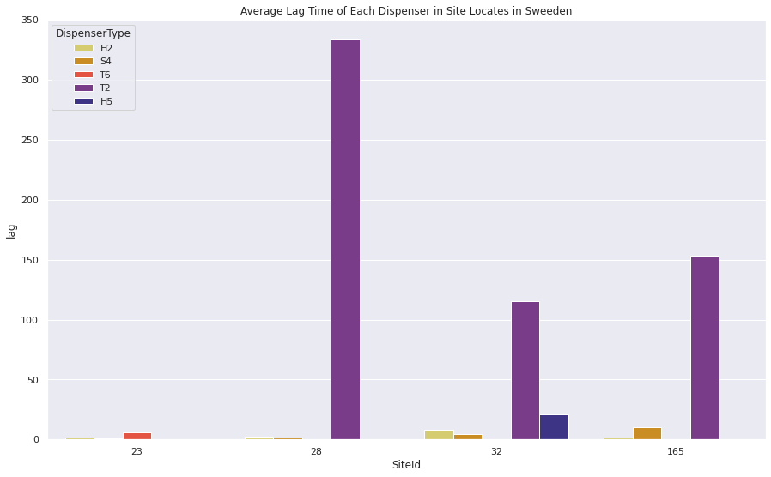
Lag Time Analysis in Sweden

Slide 9
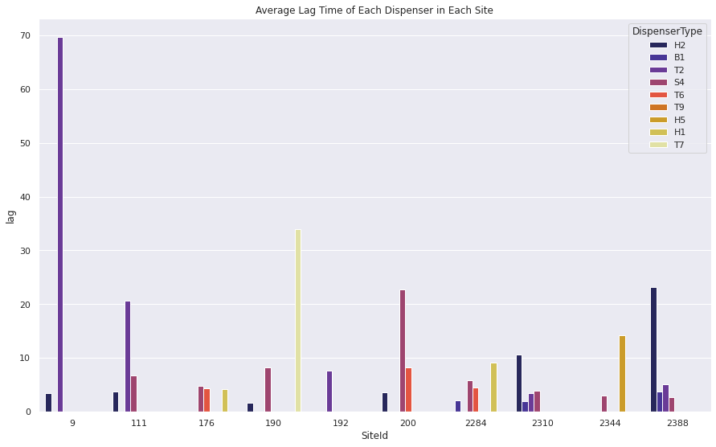
Lag Time Analysis in Other Sites

Slide 10
Sensor Status Prediction
Data cleaning and preprocessing
Model for prediction and its evaluation
Long Short-Term Memory (LSTM) for time series data
Random Forest and Neural Network for classification

Slide 11
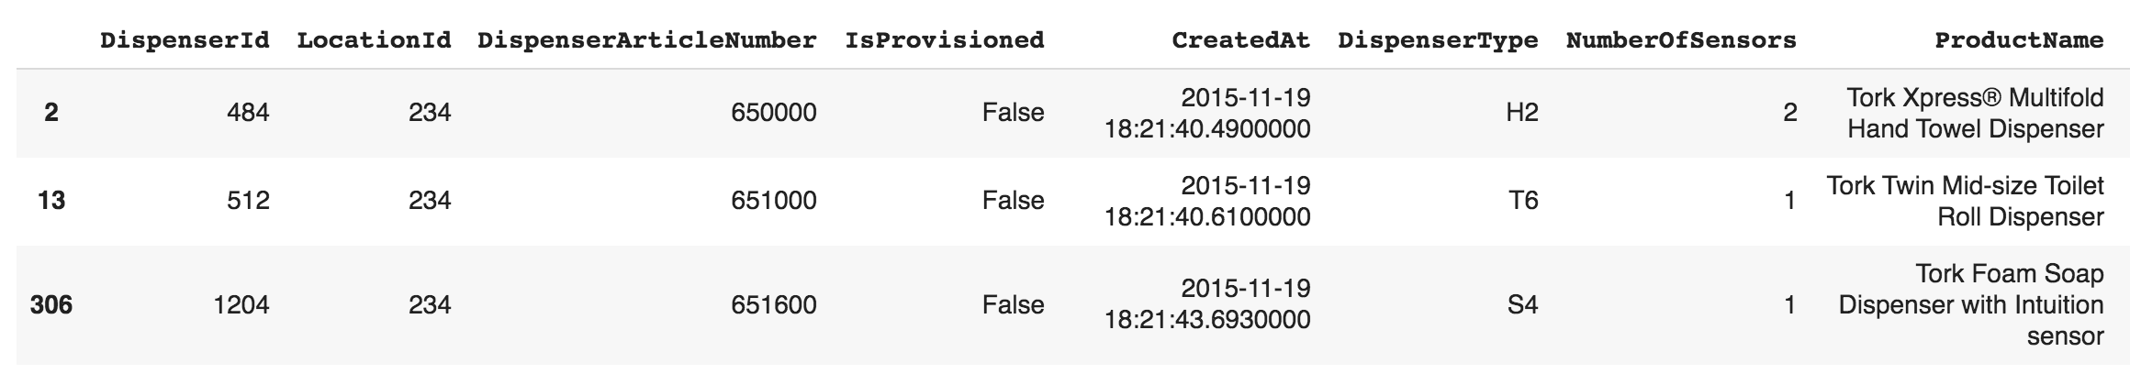
Select dispensers at a particular location
Typically, 1 ~ 3 dispensers are allocated at a particular location
Maybe more than one sensor installed in a dispenser
One location has exactly one people counter sensor

Slide 12
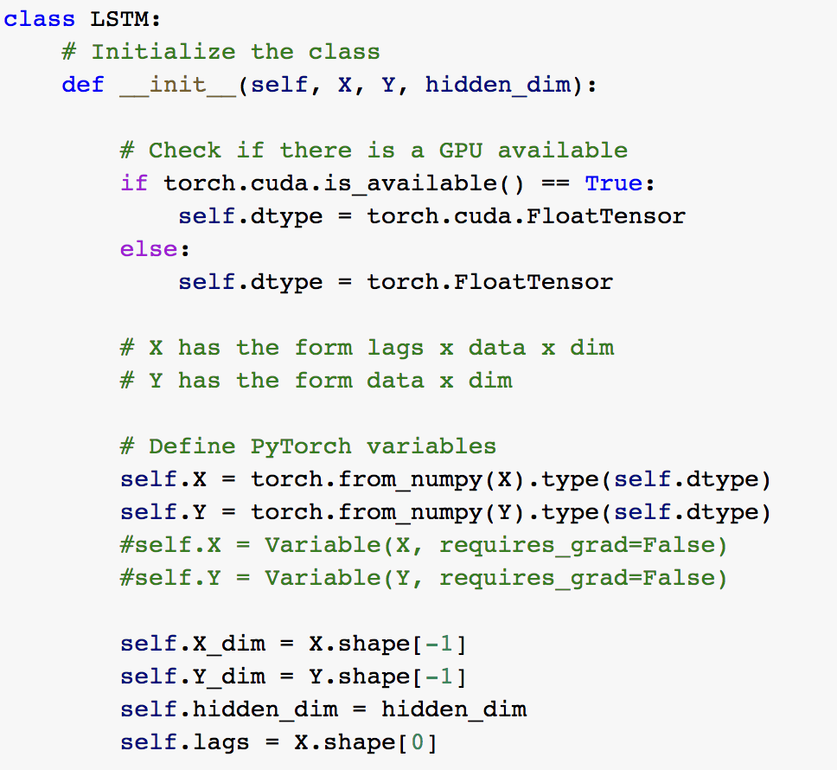
Use LSTM Network to predict the next-state dispenser sensor data with lag of length 12.
Use Random Forest/Neural Network to predict the sensor status (‘green’, ‘yellow’, ‘red’).
LSTM Network was performed by using Pytorch with GPU available.

Slide 13
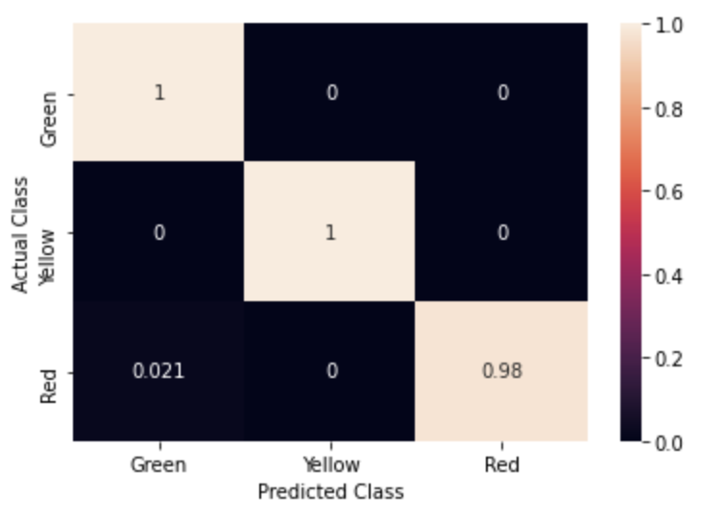
Root-Mean-Square-Error for the prediction of the sensor data is around 65.
Recall value for Random Forest model: 0.979
F1 score for Random Forest model: 0.989
Recall value for Neural Network model: 0.965
F1 score for Neural Network model: 0.943
Use Grid-Search to tune hyperparameters

Slide 14
Future Strategies
Explore the standard deviation of the average lag time for each dispenser type.
Identify green-yellow-red transition for more accurate average lag time analysis.
Use more sensor data from various locations/sites for model training.

Slide 15
Conclusion
Average lag time was analyzed between dispensers run out of product and dispensers refilled.
Models were built and evaluated in order to predict if dispensers will run out of product in the next state.
The lag time between alert and refill could be potentially eliminated if the model has high performance.
Models with more accurate prediction lead to time/money-saving working agenda.

